Slide 1
Chapter 5
Macro & Micro

Slide 2
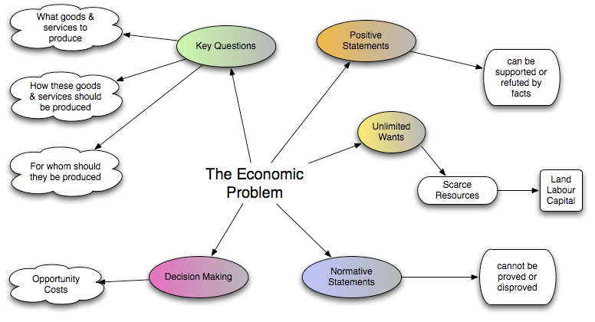

Slide 3
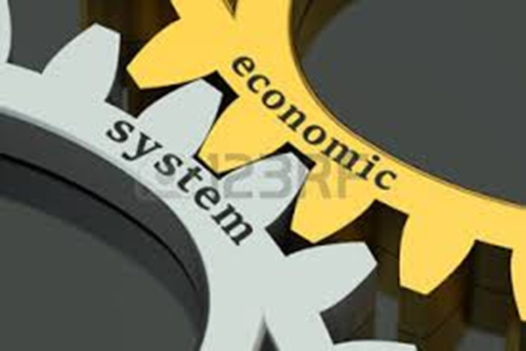
What does 'Economy' mean
Economy is the large set of inter-related production and consumption activities that aid in determining how scarce resources are allocated. This is also known as an economic system.
BREAKING DOWN 'Economy'
Economy encompasses all activity related to production, consumption and trade of goods and services in an area.
Economy applies to everyone from individuals to entities such as corporations and governments.
The economy of a particular region or country is governed by its culture, laws, history, and geography, among other factors, and it evolves due to necessity. For this reason, no two economies are the same.

Slide 4
What is Economics?
Economics is divided into two main fields of study
Microeconomics: Studies the behaviors of INDIVIDUALS within an economy: Consumers and producers in particular markets. Examples of microeconomic topics:
The Automobile market in Switzerland,
the market for movie tickets in Zurich,
the market for airline tickets between the US and Europe,
the market for vacations to Spain,
the market for international school teachers.
Macroeconomics: Studies the total effect on a nation's people of all the economic activity within that nation. The four main concerns of macroeconomics are:
total output of a nation,
the average price level of a nation,
the level of employment (or unemployment) in the nation and
distribution of income in the nation
Examples of macroeconomic topics:
Unemployment in Canada, inflation in Zimbabwe, economic growth in China, the gap between the rich and the poor in America

Slide 8
Decision makers in economics
Economic agent
Household/Firms/Governments
Private sector
Firms owned by shareholders & individuals
Government
Provides some service and goods through taxes & regulates private sector
Aims of economics decision makers
Households (consumers) low price good quality
Households (workers) high pay good conditions
Households (saver) high return
Firms make as much profit
Governments macro economic aims of low unemployment/low inflation/markets working properly

